Slide 1
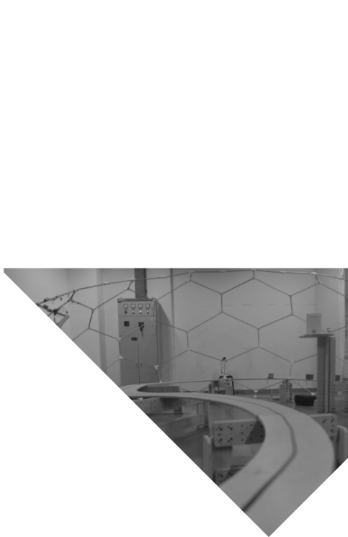

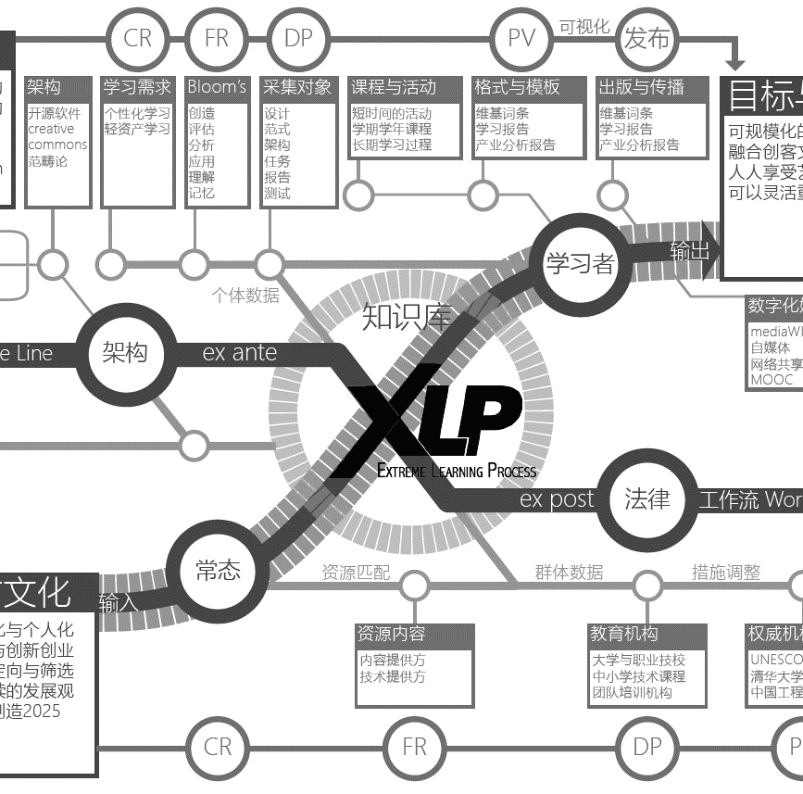

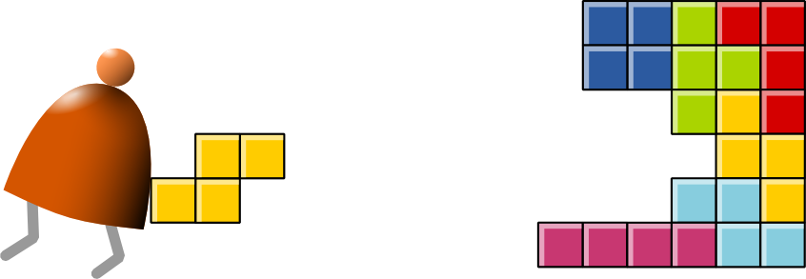
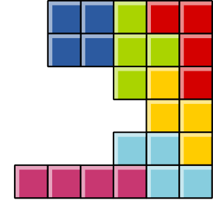

《计算思维与系统设计基础》 第二讲
从逻辑符号到算数系统
主讲老师：顧學雍
课程助教：侯煜欣、孙喆、林东生
课程wiki主页：toyhouse.cc
2016年秋 周四 19：20~21：50
地点：第六教学楼A113

Slide 2
背景
计算思维是一个基于可经由形式化语言描述目标与可经由逻辑检验条件的思考方式
逻辑模型是用自然语言描述的形式化设计合约
工程系统的开发，应该从设计合约出发，（Nand2Tetris提供了一套学习计算机架构用的全栈测试与仿真系统）
目标
解释如何用逻辑符号运算的方式实现算数系统的功能，其限制为何？
Multiplexer (MUX)是一种选择电路功能（函数）的机制，可用于通信、选择逻辑分枝条件、函数切换等场景
何谓函数？介绍ALU，Arithmetic Logic Unit，这是一种万用函数。介绍Godel Number与形式化语言的关系
逻辑模型-课程的设计合约
效果
输出
过程
输入
各小组开始为本学期的各项任务撰写逻辑模型
了解如何用Nand或Nor闸门，实现MUX，并通过HDL Simulation的测试脚本
了解二进位的数字表达方式，并知道多位二进位的加法运算器的组成元素为何
了解ALU是计算机中唯一对运算任务执行者，所有的运算，不论是符号处理，或是数字处理，都是经由ALU的函数来完成。其他的元件都是储存或通信的功能。
根据这周的内容，开始撰写一个开发围棋系统的团队任务逻辑模型
每个人完成前week1的Nand2Tetris课中的HDL电路设计，上传源代码到GitLab项目中。
安装Python, Eclipse, NetLogo, Mathematica, PHP等软件开发工具
用逻辑化的形式语言（伪代码，或是Python, Mathematica的逻辑判断式）撰写围棋的下棋规则
每周Wiki上的团队与个人学习报告
通过对ALU, Godel Number的介绍，解释为何图灵计算机具备万用的计算能力
展示围棋与Cellular Automata、逻辑电路的类比对应关系，介绍这些系统为何能做成具有图灵完备性的计算机。
to ”Software”, so that students can experience how layers of languages interact
课堂讲解
toyhouse.cc Wiki-based Knowledge Collection System
Gitlab 服务
Nand2Tetris Software
参考书目：Test Driven Development with Python
安装Django, Tensorflow等软件
辕询提供的软件范例
Painting in HTML5
PHP-based Blockchain code
外部因素
学生们在安装各种工具可能碰到不同的技术问题，造成进度落后
同学们在完成个别任务之后，没有从整个项目的系统角度思考任务之间的联系，造成前后工作不易衔接
只偏重抽象理论，或是只专注于技术细节，故而未能储备足够的知识去体会系统设计的全局性视角

Slide 3
第一周回顾: Design by Contract 基于（逻辑）合约的设计
内容:
系统的可信度，来自通过设计合约的程度 Trust worthiness is based on Design Contract
根据真值表决定设计是否合格 Truth Table is the Contract for Logic Circuit Design
课上汇报：各小组把我上周用英文写的逻辑模型翻译成中文的版本
复杂性来自简单元件的链接关系 Complexity comes from the connections of simple things
You should be watching Nand2Tetris and Computational Structure’s first week video
Learn the whole stack by building a Blockchain-recorded Go game

Slide 4
01
课程背景
01

Slide 5
一个形式化语言实现一种计算模型
The era of Super-Human Intelligence
The classification of intelligence is determined by the use of Languages
Formal Languages has computable objects: Vocabulary, Grammar, Semantics
From Logics to Number Systems: The Workhorse of Turing Complete Computation: Arithmetic Logic Unit
Memory: The Space-Time Entanglement of Digital Circuitry
Composition: The idea behind the assembly language
From Binary Notation to Human Mnemonics

Slide 6
现代计算系统是多层形式化语言的迭代结构
Human
Abstract design
Software
Thought
abstract interface
hierarchy
Chapters 9, 12
H.L. Language
Compiler
&
abstract interface
Operating Sys.
Chapters 10 - 11
Virtual
VM Translator
Machine
abstract interface
Chapters 7 - 8
Assembly
Language
Assembler
Chapter 6
abstract interface
Computer
Machine
Architecture
Language
abstract interface
Chapters 4 - 5
Gate Logic
Hardware
abstract interface
Platform
Chapters 1 - 3
Electrical
Hardware
Chips &
Engineering
Logic Gates
Physics
hierarchy
(Abstraction–implementation paradigm)

Slide 7
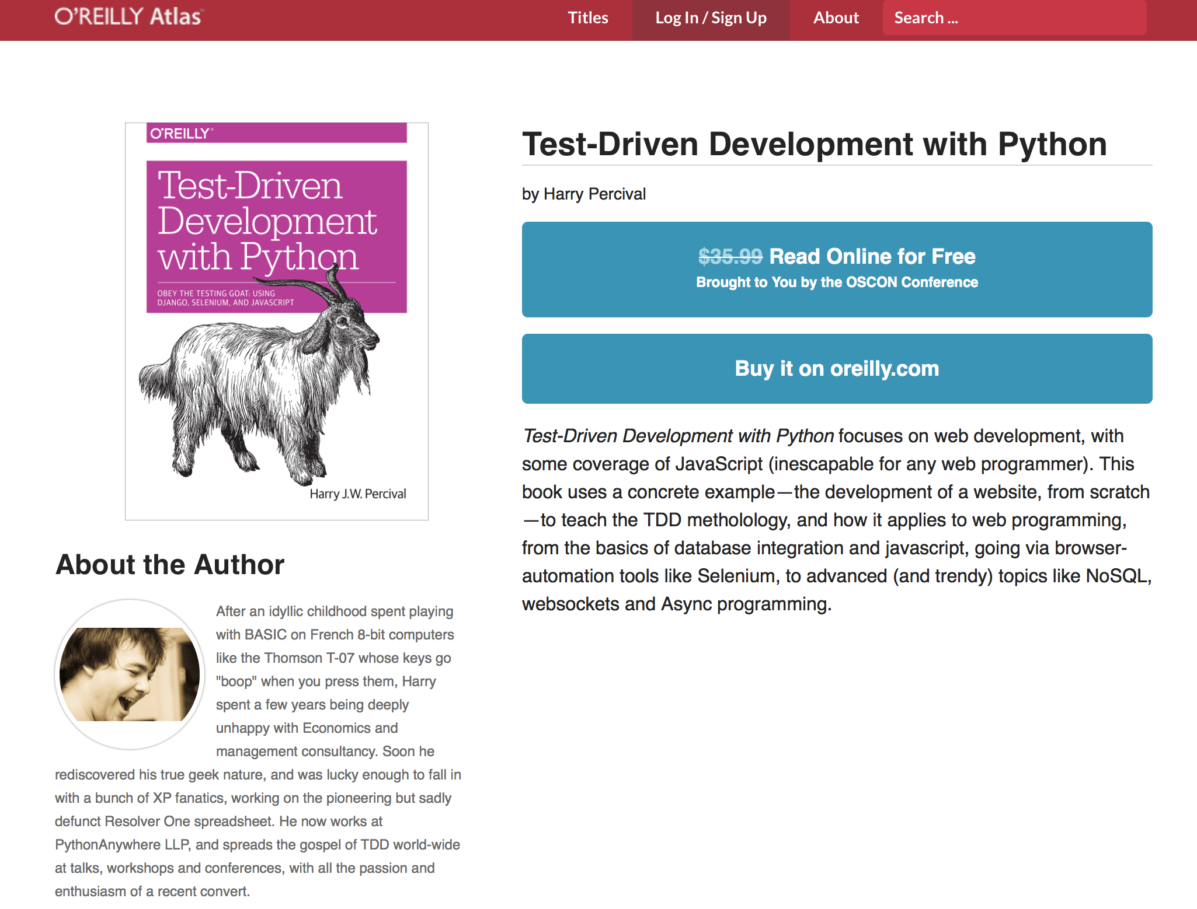
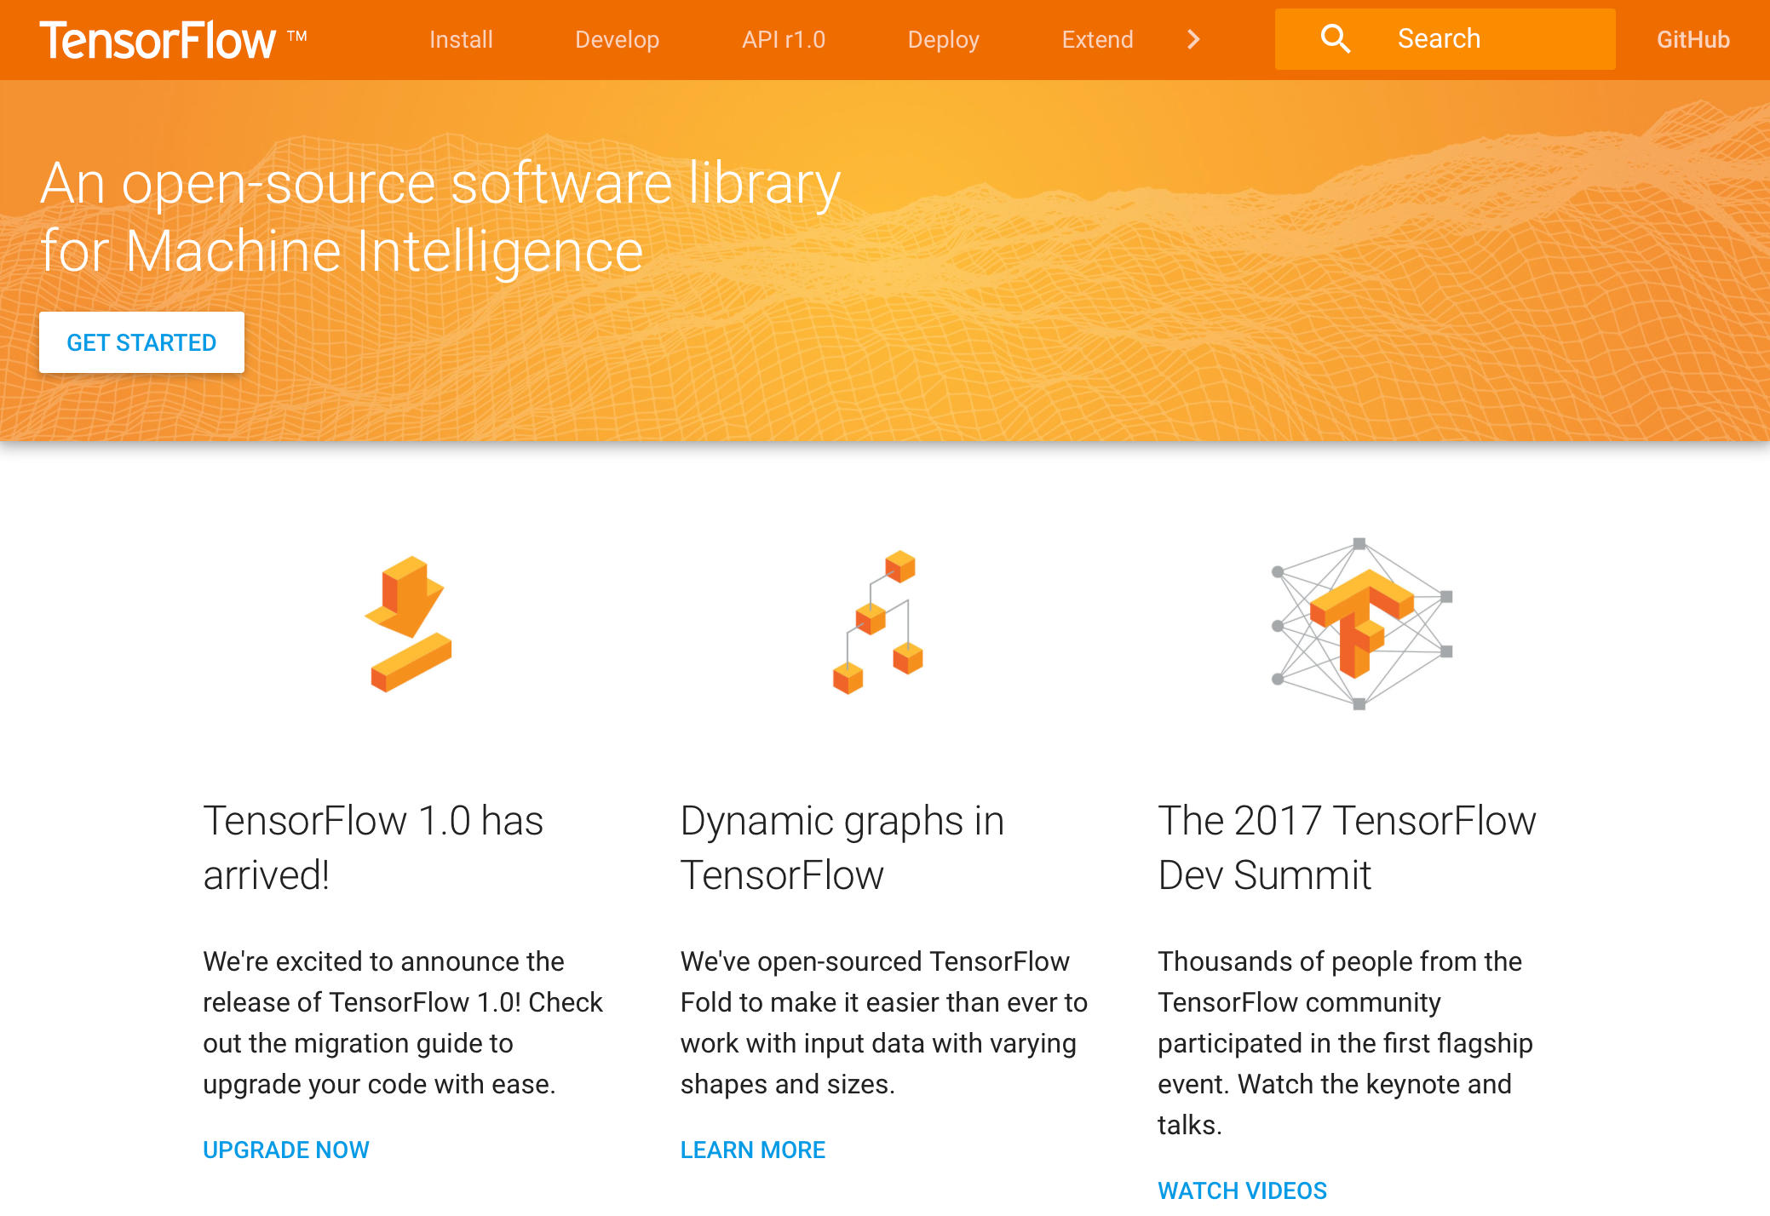
Tools and Books are freely available for building complex systems
http://chimera.labs.oreilly.com/books/1234000000754/index.html

Slide 8
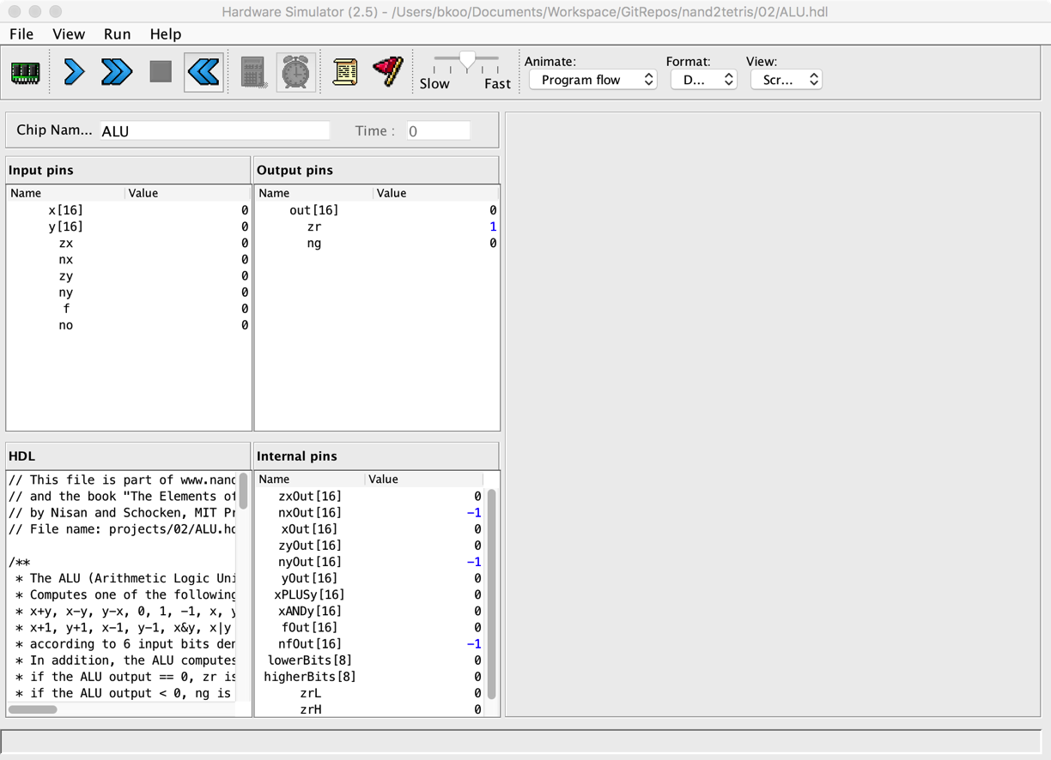
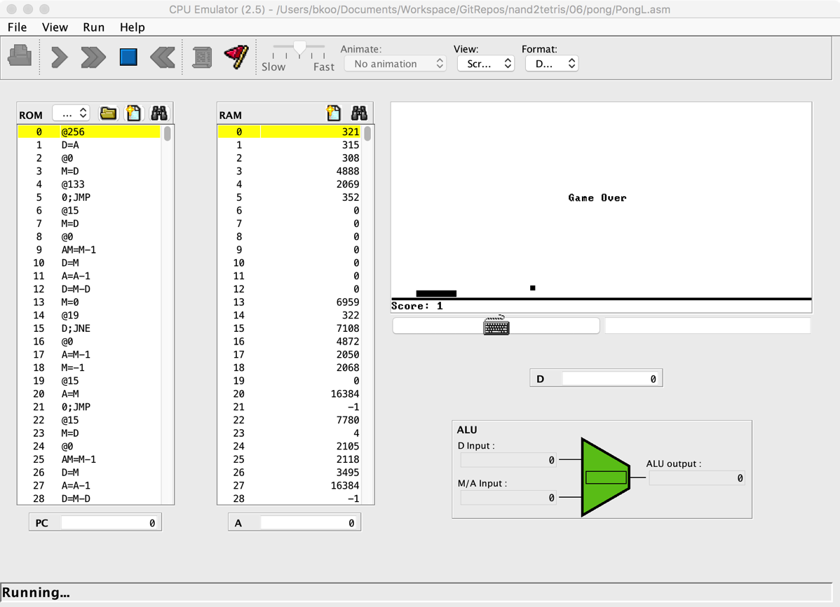
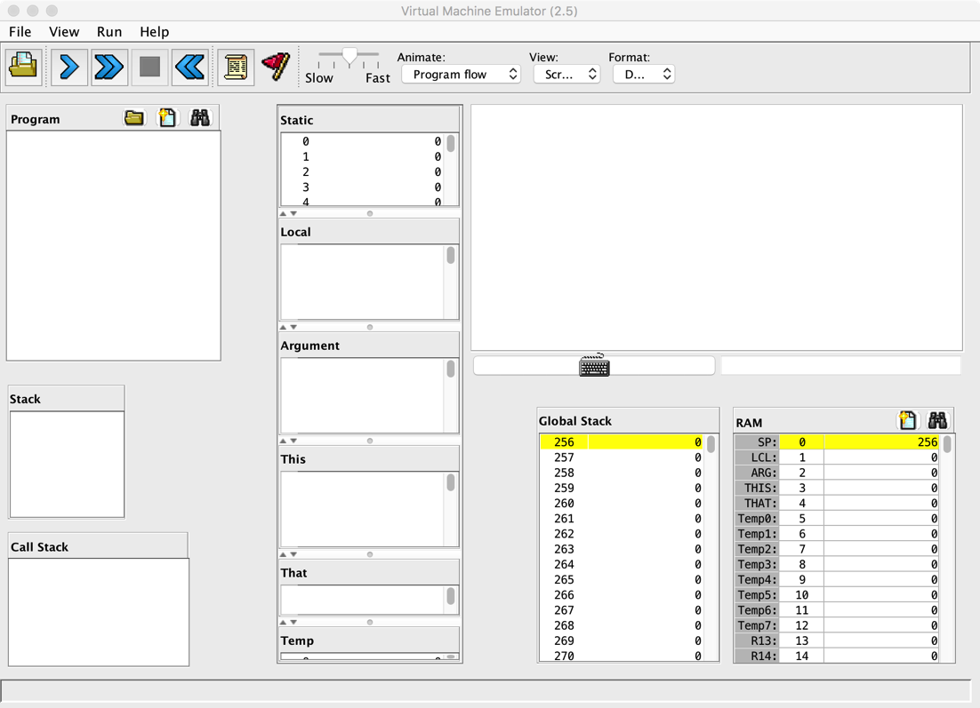
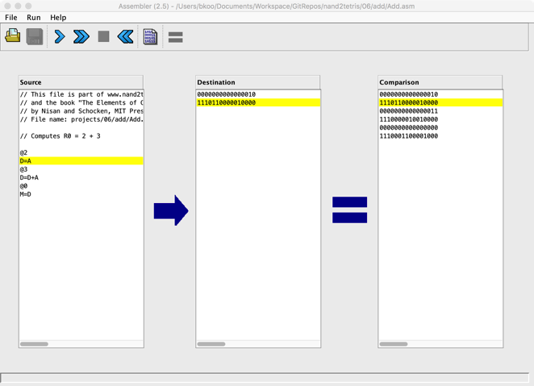
模块化项目 + 自动检验工具

Slide 9
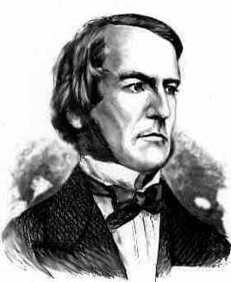

Boolean algebra
Given: Nand(a,b), false
We can build:
Not(a) = Nand(a,a)
true = Not(false)
And(a,b) = Not(Nand(a,b))
Or(a,b) = Not(And(Not(a),Not(b)))
Xor(a,b) = Or(And(a,Not(b)),And(Not(a),b)))
Etc.
George Boole, 1815-1864
(“A Calculus of Logic”)
極限學習過程

Slide 10
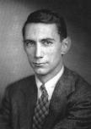
Gate logic
Interface
Claude Shannon, 1916-2001
(“Symbolic Analysis of Relay and Switching Circuits” )
Implementation
極限學習過程
Xor(a,b) = Or(And(a,Not(b)),And(Not(a),b)))

Slide 11
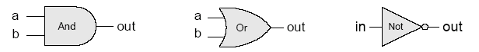
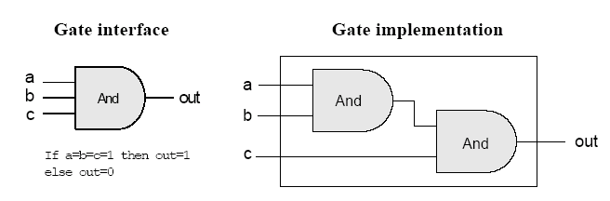
Gate logic
Gate logic – a gate architecture designed to implement a Boolean function
Elementary gates:
Composite gates:
極限學習過程
Important distinction: Interface (what) VS implementation (how).

Slide 12
Circuit implementations
極限學習過程
From a computer science perspective, physical realizations of logic gates are irrelevant.

Slide 13
Multiplexer
a b sel out
0 0 0 0
0 0 1 0
0 1 0 0
0 1 1 1
1 0 0 1
1 0 1 0
1 1 0 1
1 1 1
sel out
0 a
1 b
Proposed Implementation: based on Not, And, Or gates.
極限學習過程

Slide 14
Example: Building an And gate
Contract:
When running your .hdl on our .tst, your .out should be the same as our .cmp.
And.cmp
a b out
0 0 0
0 1 0
1 0 0
1 1 1
And.hdl
And.tst
CHIP And
{ IN a, b;
OUT out;
// implementation missing
}
load And.hdl,
output-file And.out,
compare-to And.cmp,
output-list a b out;
set a 0,set b 0,eval,output;
set a 0,set b 1,eval,output;
set a 1,set b 0,eval,output;
set a 1, set b 1, eval, output;
極限學習過程

Slide 15
Building an And gate
Interface: And(a,b) = 1 exactly when a=b=1
And.hdl
CHIP And
{ IN a, b;
OUT out;
// implementation missing
}
極限學習過程

Slide 16

Building an And gate
Implementation: And(a,b) = Not(Nand(a,b))
And.hdl
CHIP And
{ IN a, b;
OUT out;
// implementation missing
}
極限學習過程

Slide 17
Building an And gate
Implementation: And(a,b) = Not(Nand(a,b))
And.hdl
CHIP And
{ IN a, b;
OUT out;
// implementation missing
}
極限學習過程

Slide 18
Building an And gate
Implementation: And(a,b) = Not(Nand(a,b))
And.hdl
CHIP And
{ IN a, b;
OUT out;
Nand(a = a, b = b, out = x);
Not(in = x, out = out)
}
極限學習過程

Slide 19
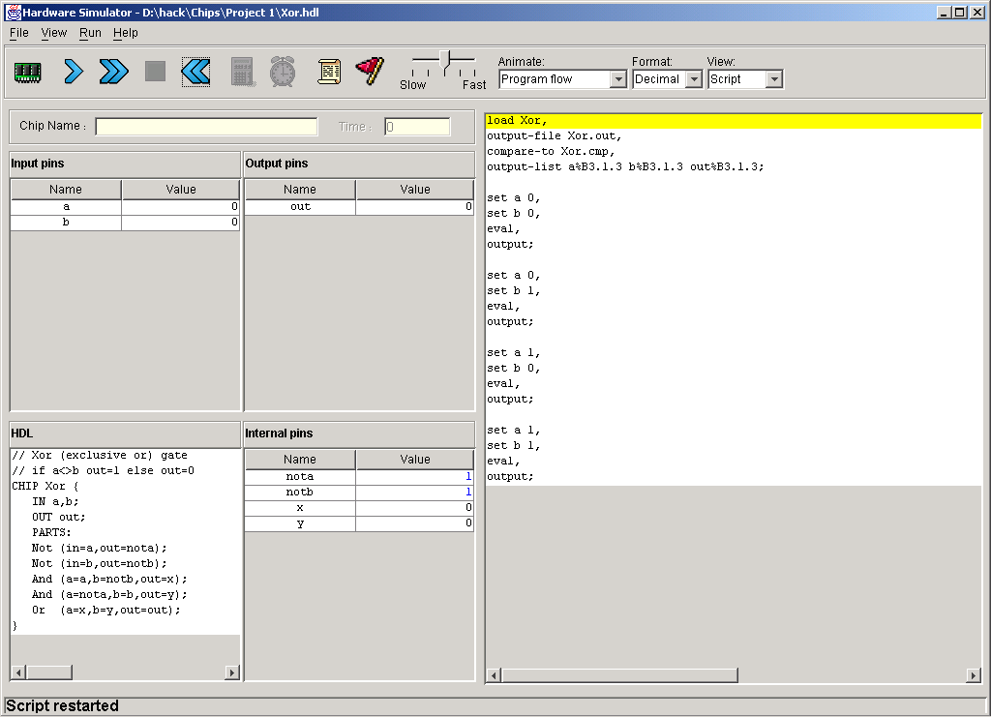
Hardware simulator (demonstrating Xor gate construction)
HDL program
test script
極限學習過程

Slide 20
Counting systems
quantity decimal binary 3-bit register
0 0 000
 1 1 001
 2 10 010
 3 11 011
 4 100 100
 5 101 101
 6 110 110
 7 111 111
 8 1000 overflow
 9 1001 overflow
 10 1010 overflow

Slide 21
Rationale

Slide 22
Binary addition
Assuming a 4-bit system:
0 0 0 1
1 0 0 1
0 1 0 1
0 1 1 1 0
1 1 1 1
1 0 1 1
0 1 1 1
1 0 0 1 0
+
+
no overflow
overflow
Algorithm: exactly the same as in decimal addition
Overflow (MSB carry) has to be dealt with.

Slide 23
Representing negative numbers (4-bit system)
0 0000
1 0001 1111 -1
2 0010 1110 -2
3 0011 1101 -3
4 0100 1100 -4
5 0101 1011 -5
6 0110 1010 -6
7 0111 1001 -7
1000 -8
The codes of all positive numbers begin with a “0”
The codes of all negative numbers begin with a “1“
To convert a number: leave all trailing 0’s and first 1 intact, and flip all the remaining bits
Example: 2 - 5 = 2 + (-5) = 0 0 1 0
+ 1 0 1 1
1 1 0 1 = -3

Slide 24
Building an Adder chip
Adder: a chip designed to add two integers
Proposed implementation:
Half adder: designed to add 2 bits
Full adder: designed to add 3 bits
Adder: designed to add two n-bit numbers.

Slide 25
Half adder (designed to add 2 bits)
a b sum carry
0 0 0 0
0 1 1 0
1 0 1 0
1 1 0 1
Implementation: based on two gates that you’ve seen before.

Slide 26
Full adder (designed to add 3 bits)
a b c sum carry
0 0 0 0 0
0 0 1 1 0
0 1 0 1 0
0 1 1 0 1
1 0 0 1 0
1 0 1 0 1
1 1 0 0 1
1 1 1 1 1
Implementation: can be based on half-adder gates.

Slide 27
n-bit Adder (designed to add two 16-bit numbers)
+
... 1 0 1 1 a
… 0 0 1 0 b
… 1 1 0 1 out
Implementation: array of full-adder gates.

Slide 28
The ALU (of the Hack platform)
out(x, y, control bits) =
x+y, x-y, y–x,
0, 1, -1,
x, y, -x, -y,
x!, y!,
x+1, y+1, x-1, y-1,
x&y, x|y

Slide 29
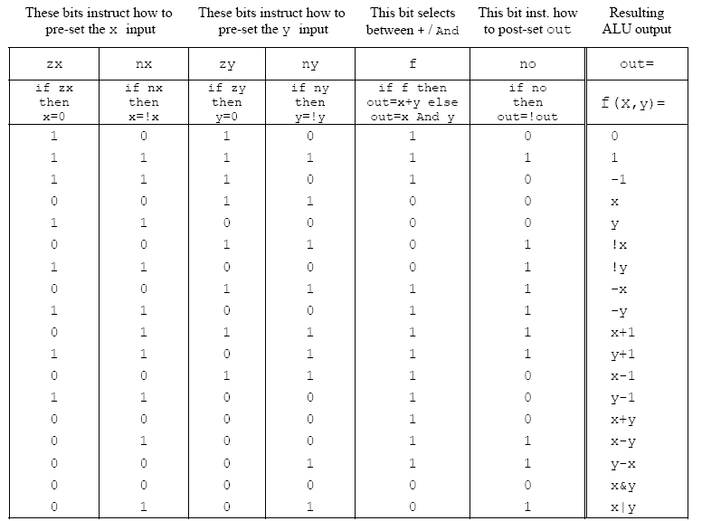
ALU logic (Hack platform)
Implementation: build a logic gate architecture that “executes” the control bit “instructions”: if zx==1 then set x to 0 (bit-wise), etc.

Slide 30
The ALU in the CPU context (a sneak preview of the Hack platform)
c1,c2, … ,c6
D
D register
a
out
A
ALU
A register
A/M
Mux
RAM
(selected register)
M

Slide 31
Perspective
Combinational logic
Our adder design is very basic: no parallelism
It pays to optimize adders
Our ALU is also very basic: no multiplication, no division
Where is the seat of more advanced math operations? a typical hardware/software tradeoff.

Slide 32
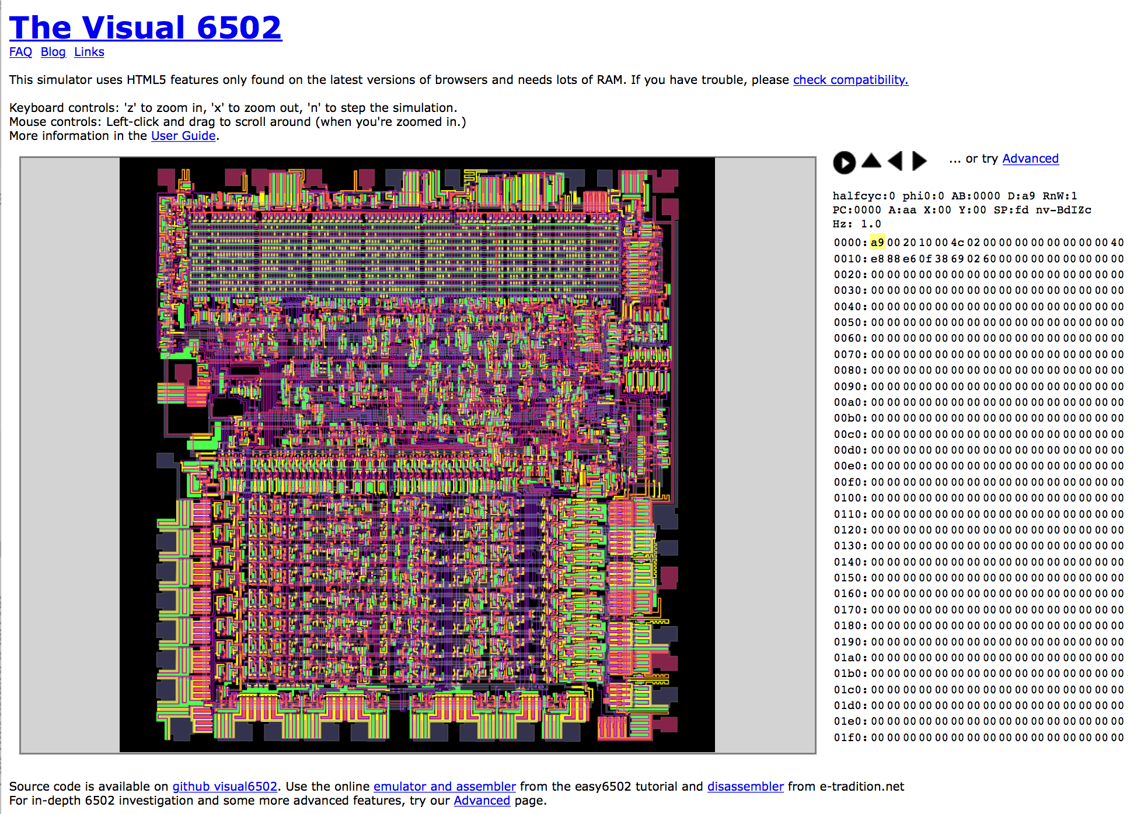
CPU 是一种图灵完备的计算单元
https://en.wikipedia.org/wiki/MOS_Technology_6502
http://www.visual6502.org/JSSim/index.html

Slide 33
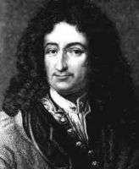
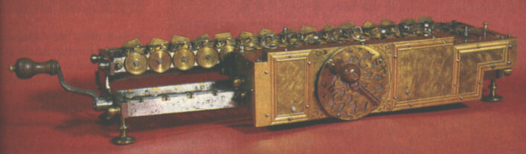
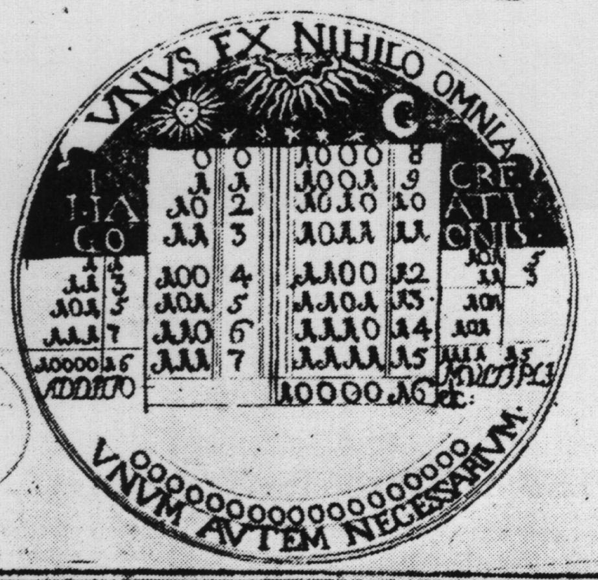
Historical end-note: Leibnitz (1646-1716)
“The binary system may be used in place of the decimal system; express all numbers by unity and by nothing”
1679: built a mechanical calculator (+, -, *, /)
CHALLENGE: “All who are occupied with the reading or writing of scientific literature have assuredly very often felt the want of a common scientific language, and regretted the great loss of time and trouble caused by the multiplicity of languages employed in scientific literature:
SOLUTION: “Characteristica Universalis”: a universal, formal, and decidable language of reasoning
The dream’s end: Turing and Gödel in 1930’s.
Leibniz’s medallion for the Duke of Brunswick

Slide 34
Gödel Numbering
Kurt Gödel’s picture from Wikipedia
In mathematical logic, a Gödel numbering is a function that assigns to each symbol and well-formed formula of some formal language a unique natural number, called its Gödel number. The concept was used by Kurt Gödel for the proof of his incompleteness theorems. (Gödel 1931)
https://en.wikipedia.org/wiki/G%C3%B6del_numbering#CITEREFG.C3.B6del1931

Slide 35
Cellular Automata
John Horton Conway
Picture from Wikipedia
Cellular Automaton picture from Wikipedia
A cellular automaton (pl. cellular automata, abbrev. CA) is a discrete model studied in computability theory, mathematics, physics, complexity science, theoretical biology and microstructure modeling. Cellular automata are also called cellular spaces, tessellation automata, homogeneous structures, cellular structures, tessellation structures, and iterative arrays.
https://en.wikipedia.org/wiki/Cellular_automaton

Slide 36
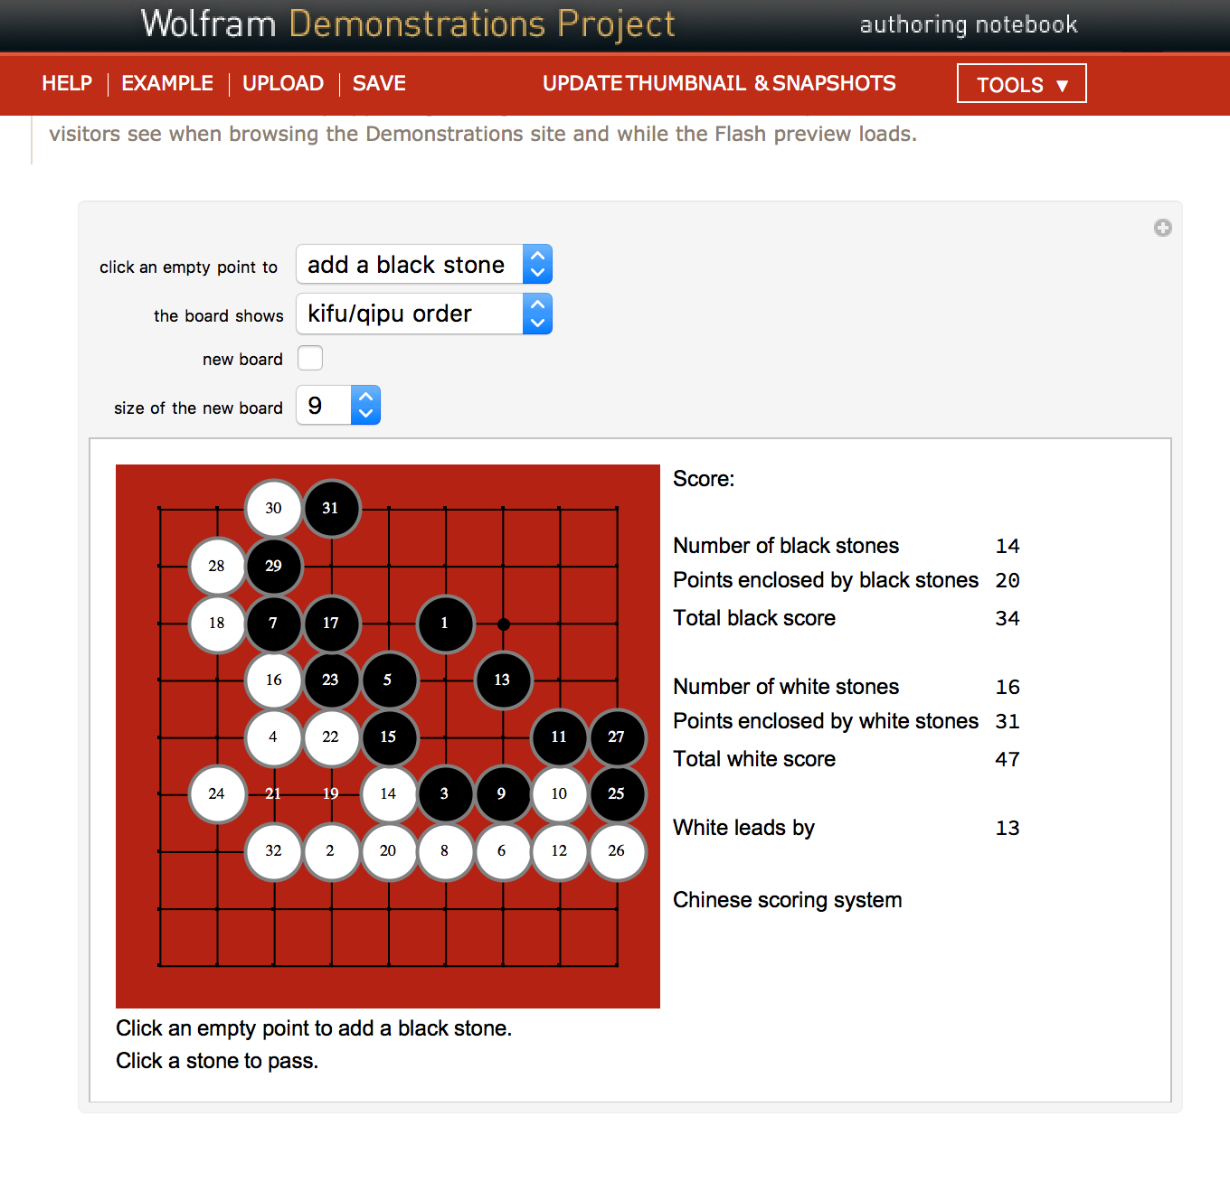
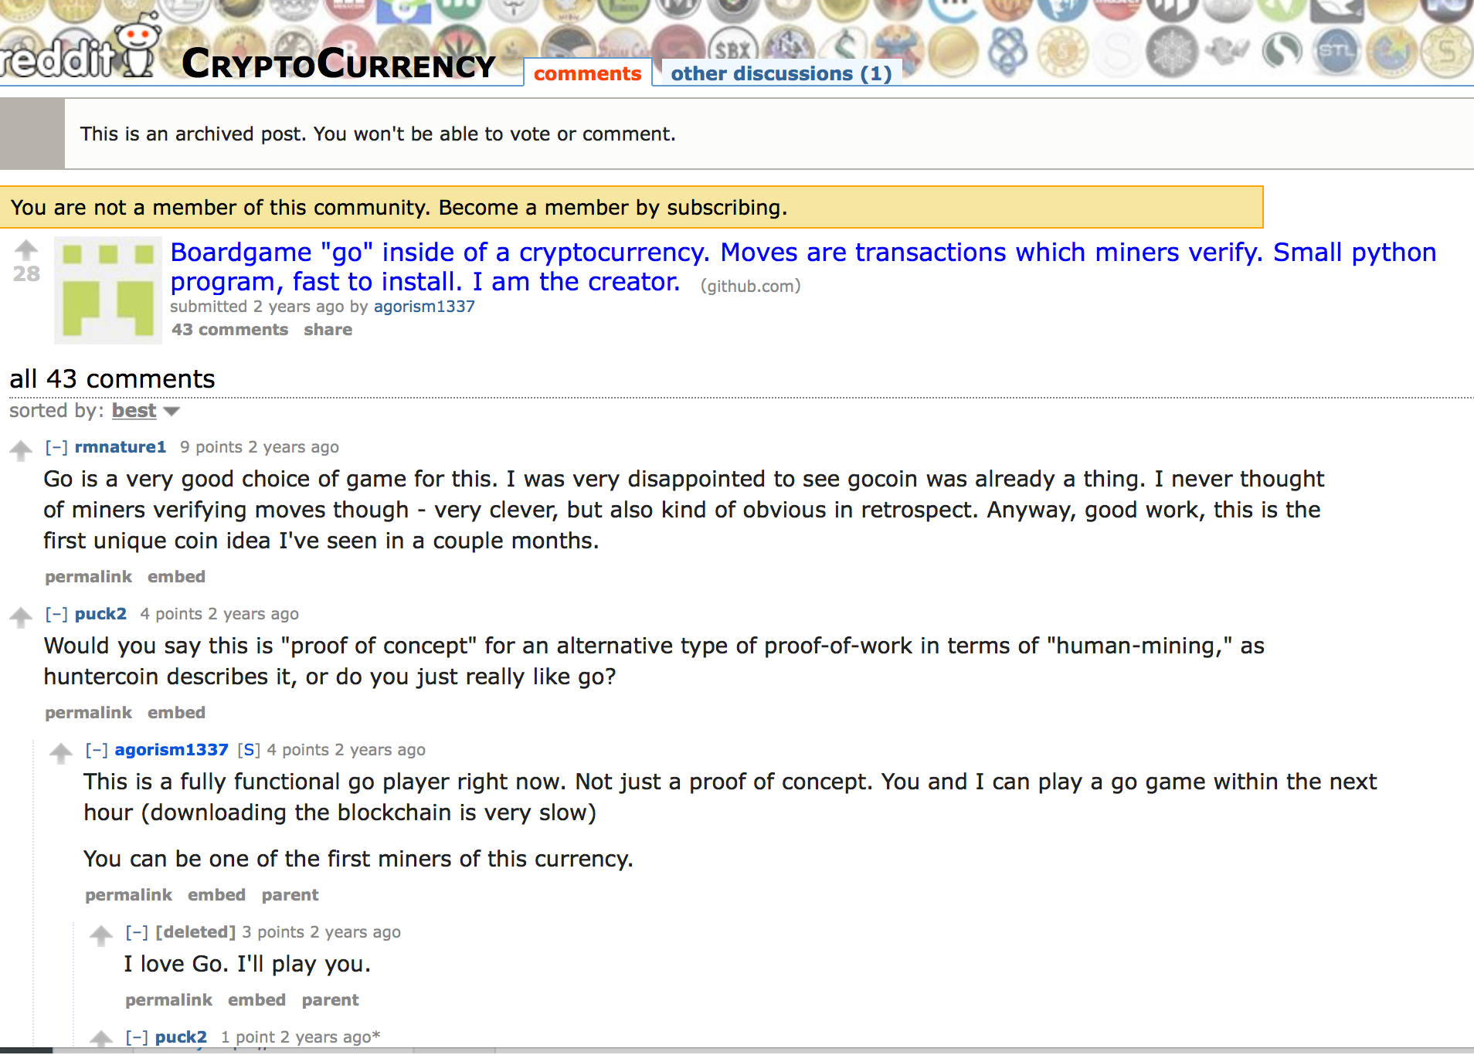
Application level: Go (by: José Luis Gómez-Muñoz)

Slide 37
课程分数的评价
Your ability in identifying proper reference material
Learn from the Internet and Public Libraries
Use relevant data sources and provide argument for its validity
Your interpretation of content
Reflected in your documentation and implementation of the Go System
The quantity and quality of efforts expended in reviewing your own work.
Reflected by wiki and Git process data

Slide 38
其他信息
如果关于课程、认知基础等问题有任何疑惑、想法、灵感，欢迎用任何方式联系我们。
孙一乔
Email：sunvianet@foxmail.com
微信：18210130968
电话：18210130968
办公室：李兆基科技大楼B559
顾学雍
Email：benkoo@mail.tsinghua.edu.cn
微信：koo0905
办公室：李兆基科技大楼B572
極限學習過程

Slide 39
THANK YOU !

